Slide 1
Box Basher
A project by Cameron Shipman and Andrew Sturdy

Slide 2
Our idea
Clicker style game
User gets points upon tapping the box.
Shop Menu allows user to purchase upgrades to increase the points they receive when playing the game
Additional hardware utilised to enhance the experience

Slide 3
Our implementation
It will use the touchscreen for displaying and navigating the UI and to play the game
An LED will flash and a buzzer will sound based on different events eg:
A tapping boost/advantage period
If the user hits a certain milestone
Notes:
Feedback:
Use real buttons instead of touchscreen
Options: two player comp game or rhythm/reaction game

Slide 4
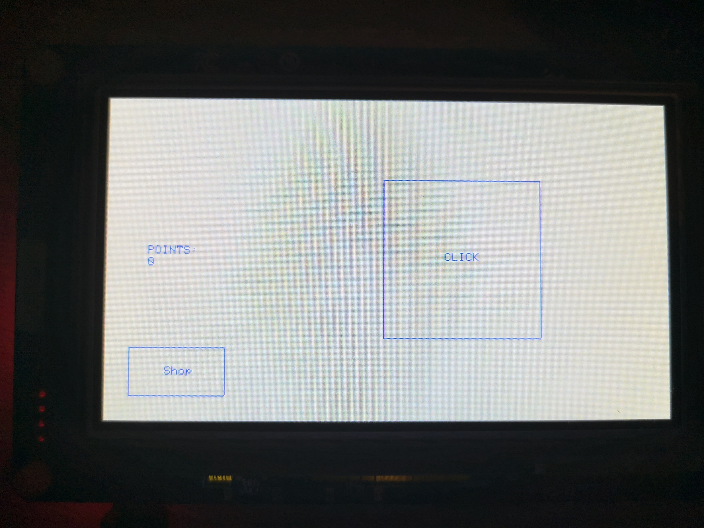
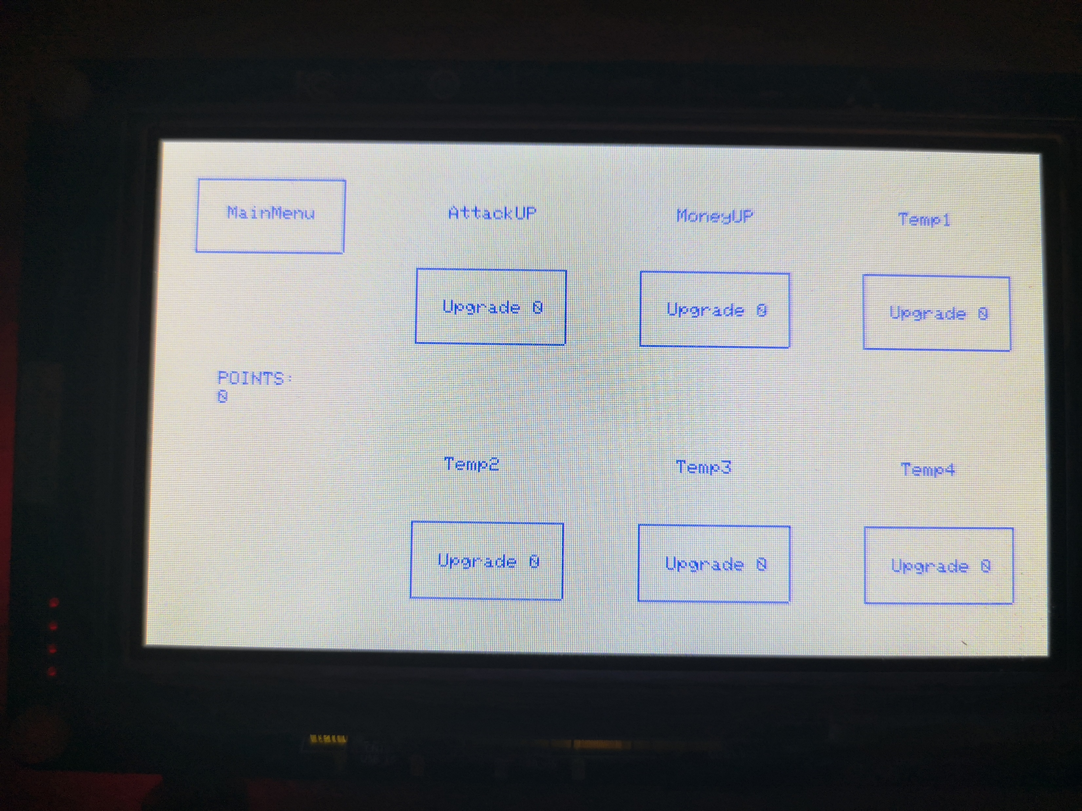
When pressed gain a point
When pressed that upgrades level will go up by 1

